Slide 1
Welcome to our presentation!

Slide 2
Project Overview
What is Spice Up Your Life?
Spice Up Your Life at its core is an online spice retail service
Allows for a speedy and straightforward purchase of popular spices
Aimed towards people that are new to cooking or need some inspiration with new recipes
Technology
This project is a web application that is built using the Spring Boot Framework. Alongside Java which is what the Spring Framework is based on there is also HTML, CSS, JavaScript, SQL and Microsoft Excel making up this application.

Slide 3
Main Features
This webapp features an online store for spices
A short-library of recipes
Membership service offering exclusive downloadable recipes and spices at a discounted rate
Easy finance tracking for the administrator using a spreadsheet to track all sales

Slide 4

Effective Communication as a Team

Slide 5
Methods of Communication
Initial email from Hamzah
Mixture of discord/teams for messages
Blend of text chats and calls
After a few weeks, just teams due to file sharing and simplicity
Used Github throughout to facilitate task assignment

Slide 6
Success of Communication
Enabled us to divide tasks equally
Also allowed us to help one another
Lost contact with one member, we don't know why, but were able to re-allocate jobs
Met the deadlines for every sprint
Each member was confident to present their work in the client meetings

Slide 7
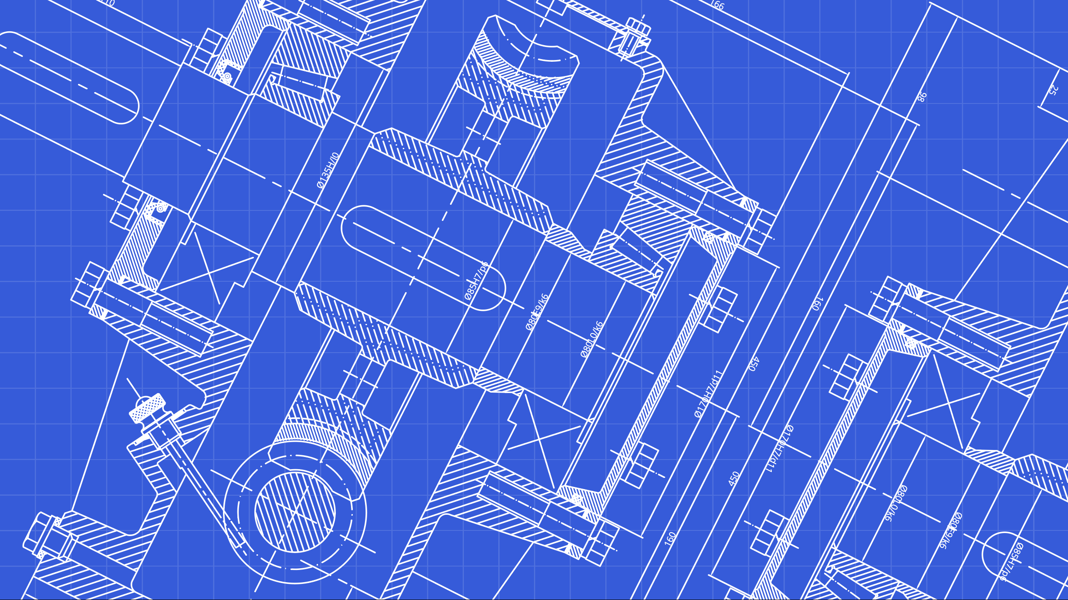
The Software Architecture of the Project

Slide 8
Development View of the Software
Java was the programming language used
Webpages were designed with HTML with inbuilt CSS and JavaScript
Spring Framework was used to handle the projects code, as it makes it easy to combine front-end and back-end development
Gradle was used to manage dependencies, so it was easy to implement security and database features
In Scrum anyone can take a task they see fit, however there was a clear split of members working on either the front-end (HTML, CSS) and back-end (databases, security).

Slide 9
Physical View of the Software Architecture
Scrum15SpringApplication
SecurityConfig
Controller
scrum15/com/controller
(includes validators)
Controller updates the model e.g. adds new user to repo, added to database
View alerts controller of event e.g. Registering new user
Model alerts view that it has been changed e.g. ask user to login
View
src/main/webapp/WEB-INF/views
+ src/main/resources/static
Model
scrum15/com/model
+ scrum15/com/repo
+ scrum15/com/service
View updates using model itself
(Java/scrum15 inside spring)
User interacts with View from browser (currently on localhost:8443)

Slide 10
Process View of the Software
Spring can run threads simultaneously and concurrently. Although there are a limited number of threads allowed to run, the database and security features do not cause the webapp to slow down and so concurrency is not an issue.
Throughput is not an issue, as there is a small amount of information currently in the database and there is a small amount of code. However, this brings us on to an issue:
Scalability could be an issue in the future depending on the number of users signing up and being added to the database. If more spices and recipes were added in the future, then not only would they have to be added to the database, but they would also have to be written into the code and HTML.
This could be easily avoided by using centralized JSPs to dynamically display the spices and recipes, so the data is all taken from the database rather than hardcoded.

Slide 11
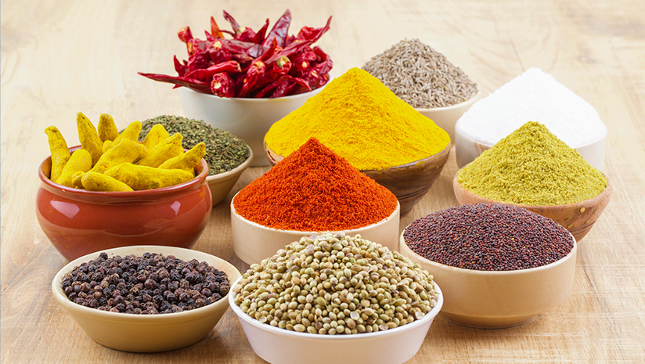
Demonstration of ordering spices from the website

Slide 12
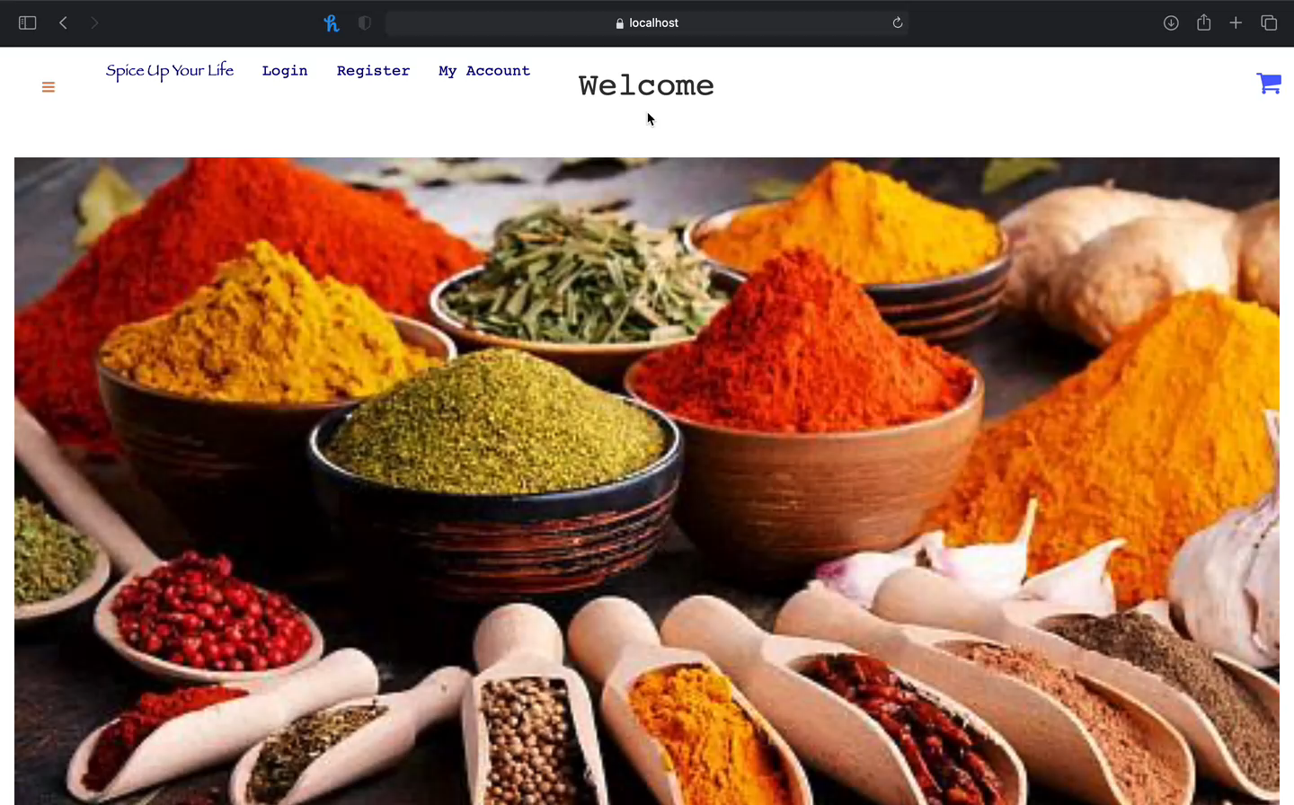
Step 1: Choose a desired spice
Filtering to make it easier to find spice
e.g., display all spices found in a recipe and sort by country

Slide 13
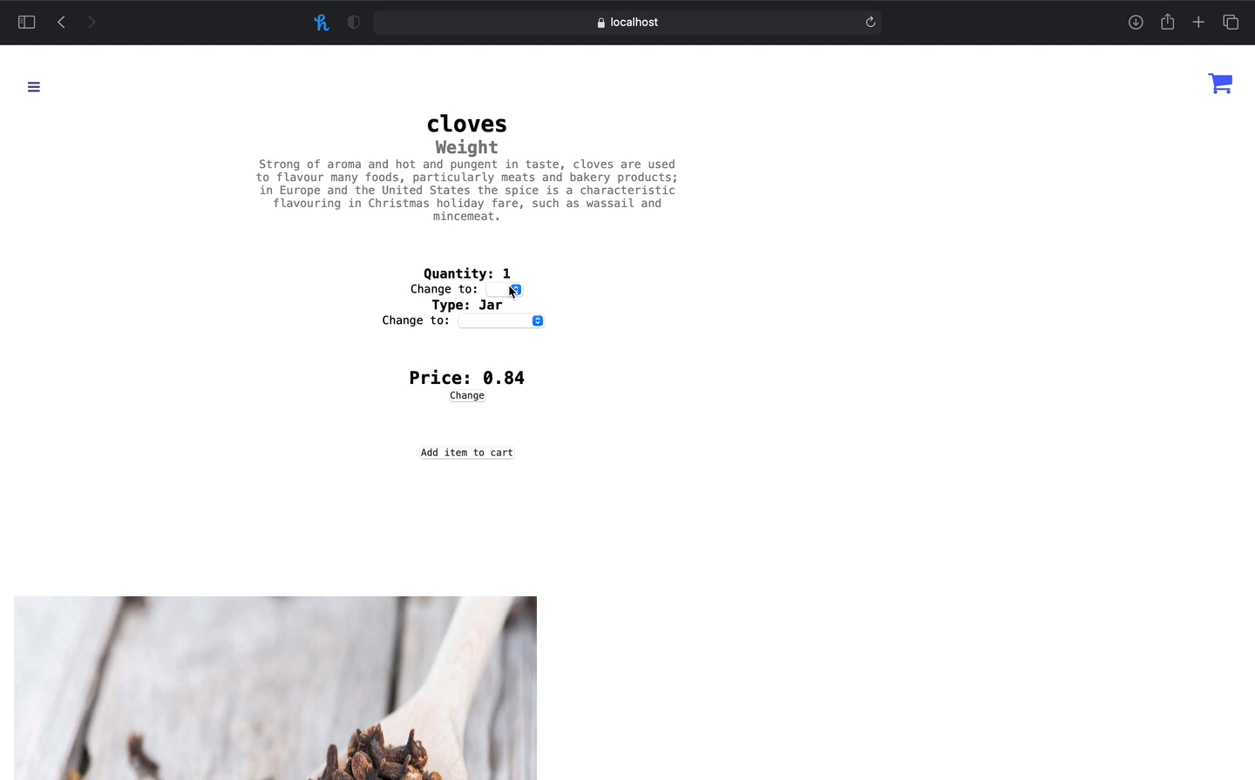
Step 2: Add spice to the basket
Ability to choose the size and quantity of spice
e.g., quantity of 7 and size of 100g (package)

Slide 14
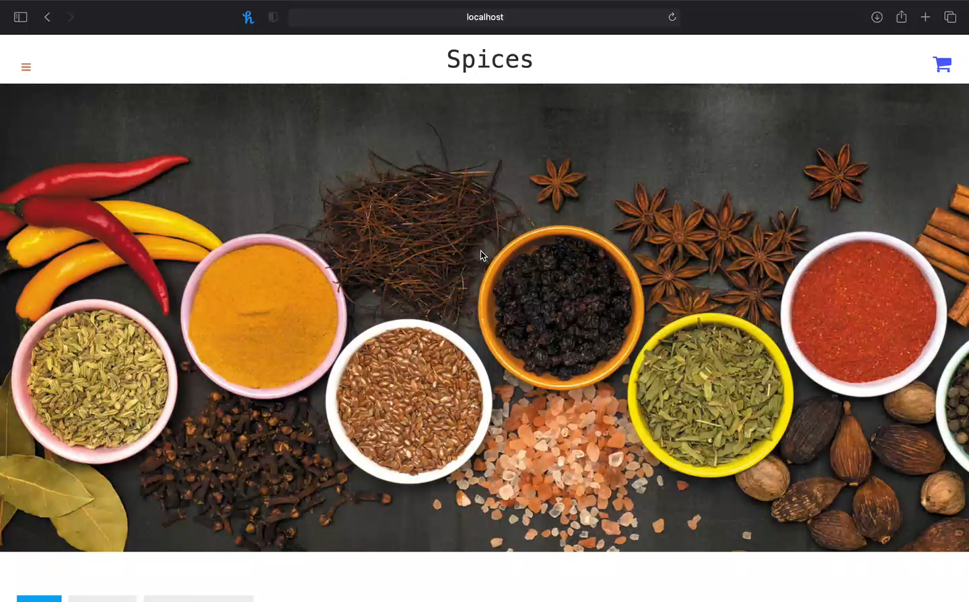
Step 3: Confirm the correct spice(s) is in the basket
Delete?
Currently there is no feature to remove spices from the basket
Will be added in the future

Slide 15
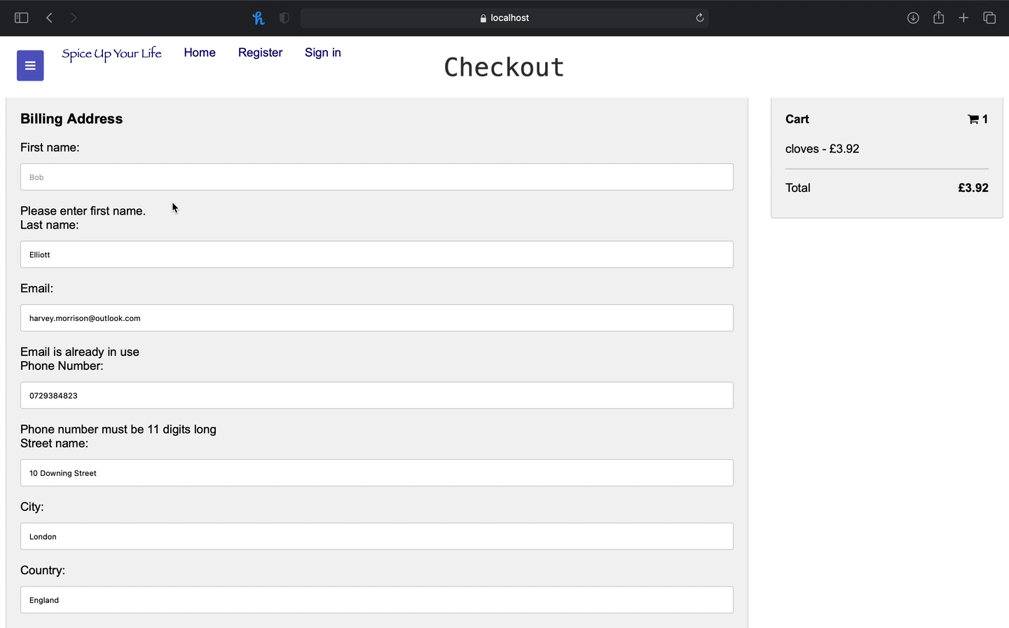
Step 4: Enter customer details
Validation
No fields are left empty
Existing email is not used
Phone number 11 digits
Card number 16 digits
Expiry date 5 characters long
Security code 3 digits

Slide 16
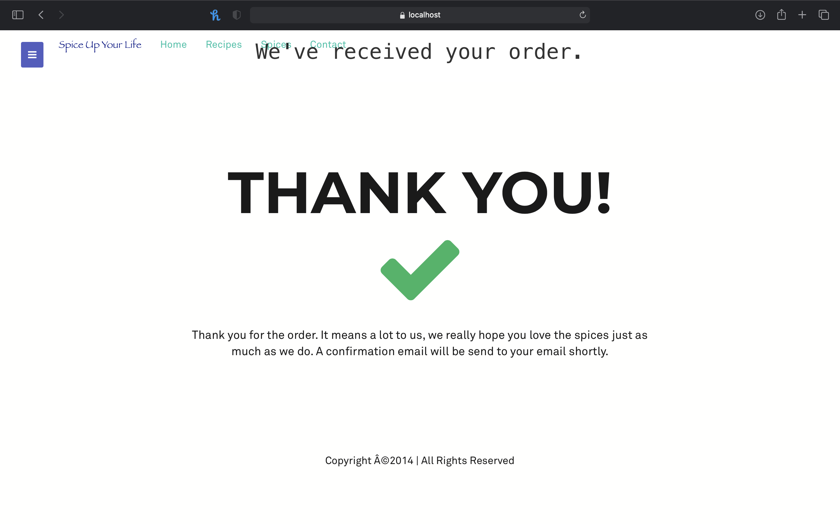
Step 5: Confirmation screen will appear

Slide 17
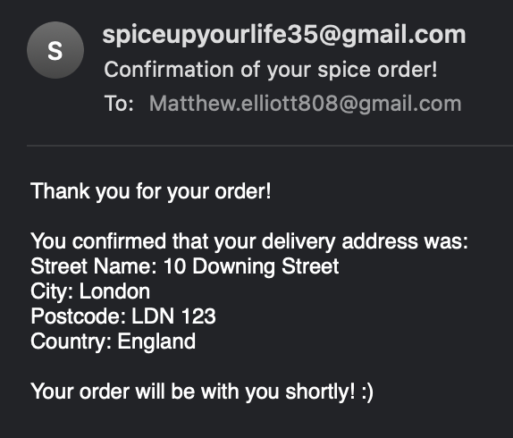
Step 6: Order confirmation email sent to user
Will be added in the future
Implemented using Spring Java Mail

Slide 18
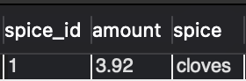
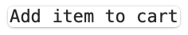
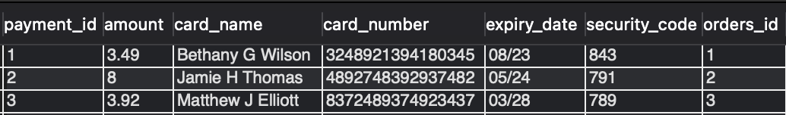
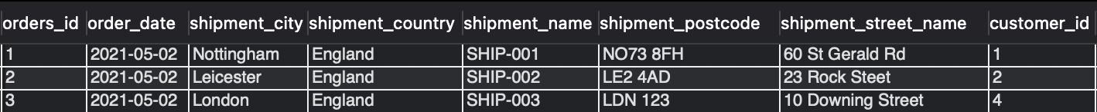
Basket item table
Customer table
Payment table
Order table

Slide 19
Future plans
Features
Integrating external tools
Security

Slide 20
Features
- Finish the incomplete
- Add new features
- Testing

Slide 21


- CMS Security plugins - SEO Evaluate website
Integrating tools and Security

Slide 22
Thank you for listening!

